Slide 1





Weather Master App
Team Members: Kavuri Partha Saradhi Naidu Guide: Uma Maheshwari R
Marekkagari Mahesh
Inakollu Rohith Kumar Reddy
Mylappagari Dinesh Kumar
Perambaduru Naveen
Disclaimer: The content is curated for educational purposes only.

Slide 2
OUTLINE
Abstract
Problem Statement
Aims, Objective & Proposed System/Solution
System Design/Architecture
System Development Approach (Technology Used)
Algorithm & Deployment
Conclusion
Future Scope
References
Images of the Project
Notes:
These are the list of chapters that we are going to cover in these foundation codes. Those are chapter one what are AI and ML? chapter 2 applied Python programming in AI, and chapter 3 is exploratory data analysis for ML.

Slide 3
Abstract
The Weather Report application is a web-based platform that provides users with comprehensive weather forecasts for various locations. Developed using Android Studio, the app leverages historical data and extracts information from the OpenWeathermap API to predict weather conditions.
Notable features include:
Forecasting: Users can access detailed weather reports for any location.
Comparison: The app allows users to compare weather conditions between two different places.
Current News: It keeps users informed about global weather news.

Slide 4
Problem Statement
Inaccurate forecasts and limited personalization have led to user frustration, emphasizing the need for precise, location-specific predictions tailored to individual preferences. The complexity of user interfaces, coupled with slow loading times, poses obstacles for seamless navigation, particularly impacting users with limited technological expertise or in areas with slower internet connectivity. Furthermore, a lack of advanced meteorological data and inadequate severe weather alerts undermines the app's utility, especially for users seeking detailed information for informed decision-making.

Slide 5
Aim and Objective
Aim:
Enhance User Experience: Improve the user interface and experience to make WeatherMaster intuitive, visually appealing, and user-friendly.
Optimize Performance: Boost the application's speed and responsiveness, especially when dealing with real-time weather data for a large number of cities.
Ensure Compatibility: Ensure consistent functionality and appearance by testing WeatherMaster across different web browsers.
Mobile Responsiveness: Guarantee the application functions seamlessly on various devices, including smartphones and tablets.
Ensure Data Accuracy and Reliability: Regularly validate weather data from the OpenWeatherMap API and implement error-handling mechanisms.
Strengthen Security: Review and enhance the security of the application to protect user data and interactions with external APIs.

Slide 6
Objectives:
Refine UI/UX: Evaluate and redesign the user interface for a seamless and visually appealing experience.
Optimize Performance: Assess and enhance application speed and responsiveness, focusing on real-time weather data handling.
Cross-Browser Compatibility: Test and address any compatibility issues across various web browsers.
Mobile Responsiveness: Implement responsive design practices to ensure compatibility with different devices.
Data Validation: Regularly validate weather data from the OpenWeatherMap API and implement error-handling mechanisms.
Security Enhancement: Review and implement secure coding practices to protect user data and external API interactions.

Slide 7
Proposed Solution
The proposed system involves a comprehensive redesign and optimization of the WeatherMaster application. Key steps include refining the UI/UX, optimizing performance, ensuring compatibility across browsers, implementing responsive design, validating data accuracy, enhancing security measures, planning for scalability, and improving documentation and coding standards.

Slide 8
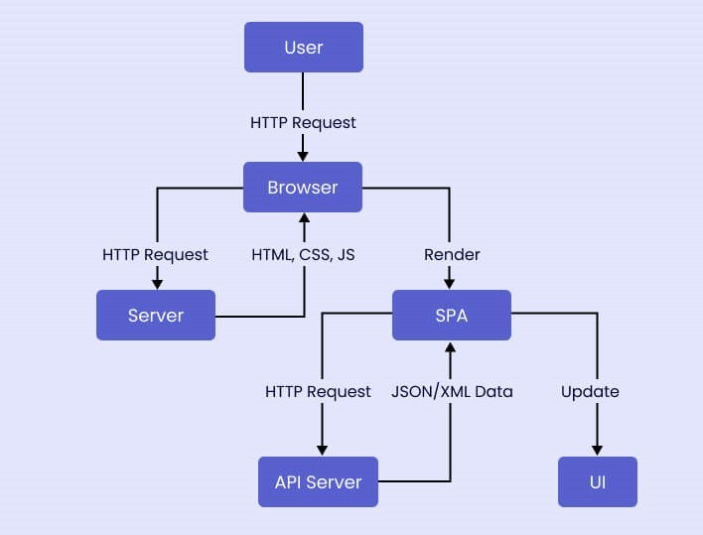
System Architecture

Slide 9
System Deployment Approach
Technologies are used:
Frontend: HTML, CSS, JavaScript, responsive design principles.
Backend: Java, Servlets, JSP for dynamic content generation.
Database: Optimize database queries for efficiency.
API Integration: OpenWeatherMap API for weather data.
Web Server: Tomcat Server.

Slide 10
Algorithm & Deployment
Algorithm: Authenticate WeatherMaster User
Input:
city: User's input for the city.
apikey: OpenWeatherMap API key.
Output:
Redirect to the index.jsp page with weather data or an error message.
1. Get User Input:
- Retrieve the values of city and apikey from the HTTP POST request.
2. API Integration:
- Create the OpenWeatherMap API URL using the provided apikey and city.
Establish an HTTP connection to the API.
3. Retrieve Weather Data:
- Read the response data from the API, including date, temperature, humidity, wind speed, and weather condition.

Slide 11
4. Parse and Process Data:
- Parse the JSON response using Gson to extract relevant weather information.
- Calculate date and time from the timestamp.
- Convert temperature from Kelvin to Celsius.
5. Set Request Attributes:
- Set request attributes for date, city, temperature, weather condition, humidity, wind speed, and raw weather data.
6. Disconnect from API:
- Disconnect the HTTP connection to the OpenWeatherMap API.
7. Forward to JSP Page:
- Forward the request and response to the index.jsp page for rendering.
End Algorithm

Slide 12
Deployment Steps:
1. Set Up the Database:
- No database setup is required for this algorithm, as it focuses on retrieving weather data from the OpenWeatherMap API.
2. Deploy Servlet and JSP Files:
- Save the provided Java Servlet code in a file (e.g., Myservlet.java).
- Ensure that the servlet is correctly mapped in the web.xml deployment descriptor.
- Deploy the WAR file to a servlet container like Apache Tomcat.
3. Configure OpenWeatherMap API Key:
- Obtain an API key from OpenWeatherMap and replace the apikey variable in the servlet code.
4. Test the Application:
- Access the servlet endpoint (e.g., http://your_server/servlet-context/Myservlet) and test the weather data retrieval functionality.

Slide 13
5. Monitor and Maintain: - Regularly monitor the application for errors. - Ensure the API key is kept secure and updated if necessary. - Keep your server software, including Java and servlet container, up to date. End Deployment

Slide 14
Conclusion
The proposed enhancements will transform WeatherMaster into a more reliable, user-friendly, and scalable weather application. Users will benefit from an improved UI/UX, faster performance, and increased security, making WeatherMaster a go-to platform for accurate and comprehensive weather insights.

Slide 15
Future Scope
Future developments could include integration with additional APIs for more diverse data, incorporating machine learning for improved weather predictions, and expanding the application to include additional features based on user feedback.

Slide 16
Reference
https://www.codementor.io/projects/web/weather-forecast-website-atx32lz7zb
Notes:
Reference
These are the references for this session.
16

Slide 17
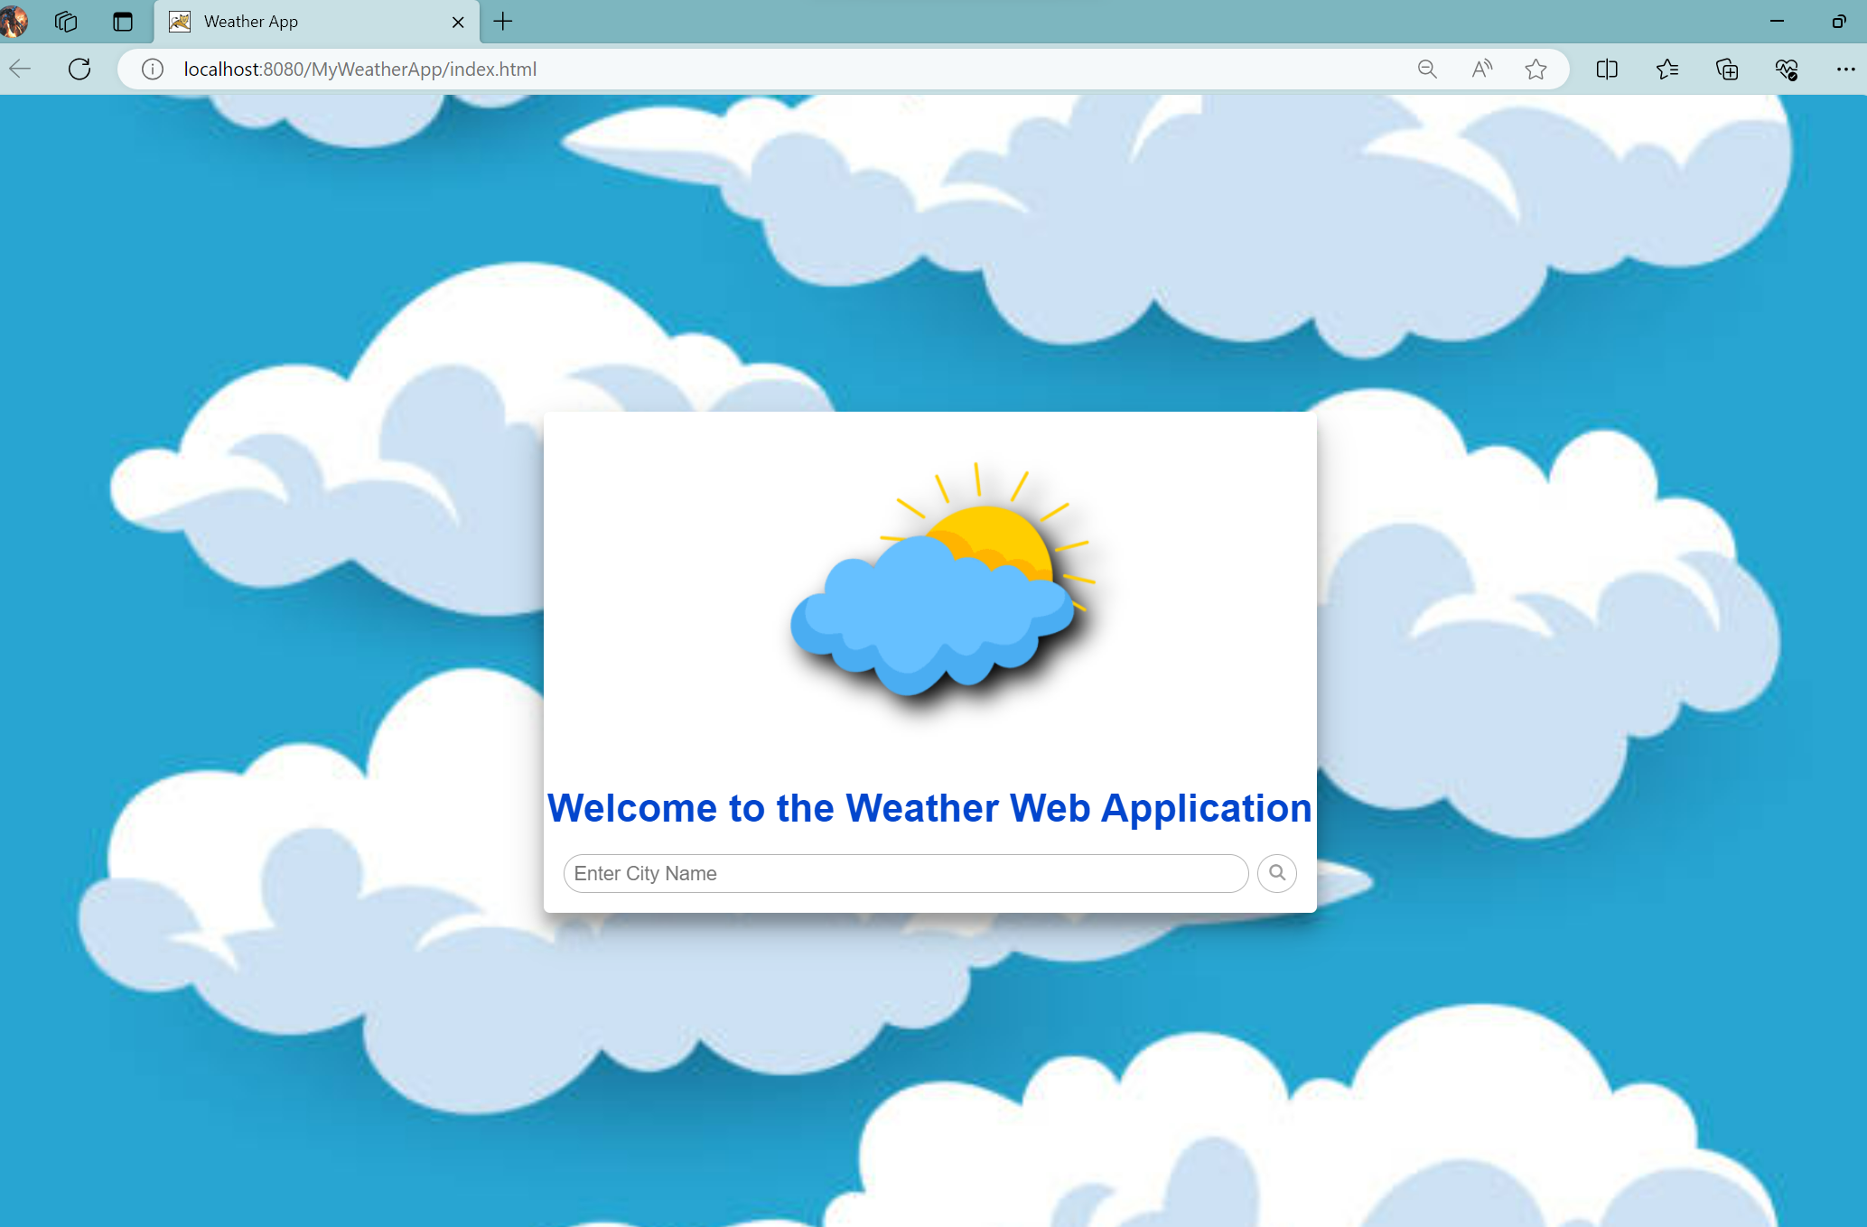
Outputs:
HTML Page:

Slide 18
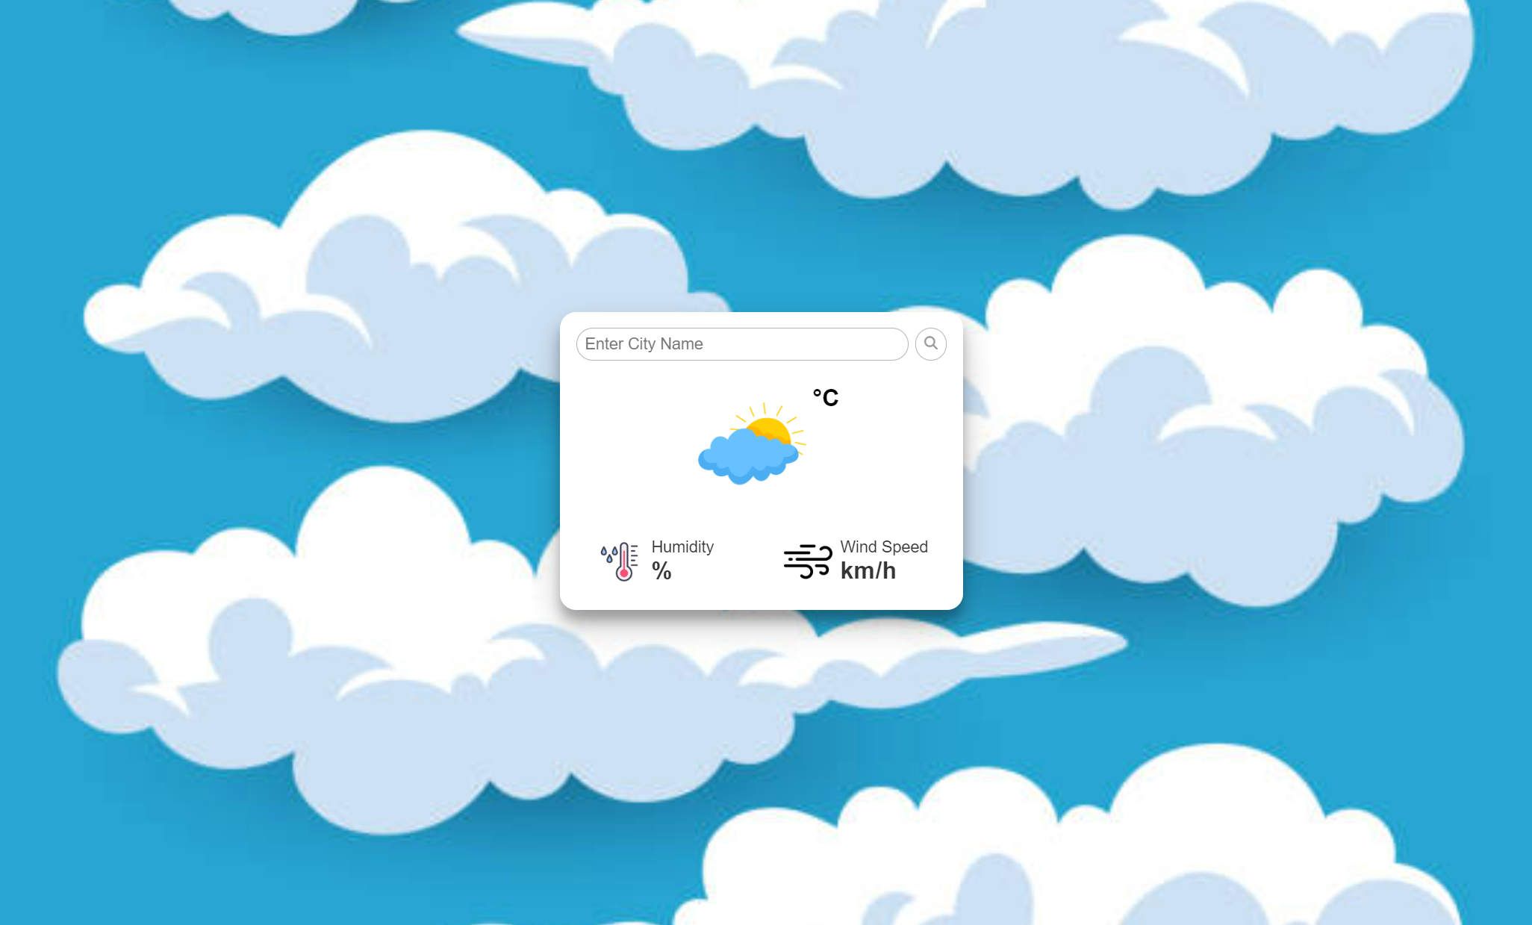
JSP Page:

Slide 19
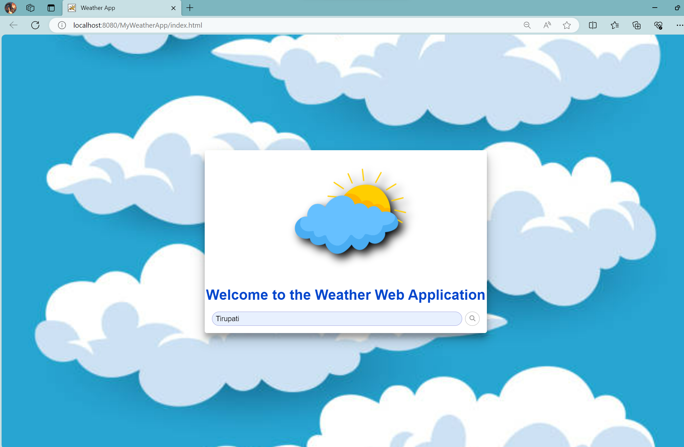

Slide 20
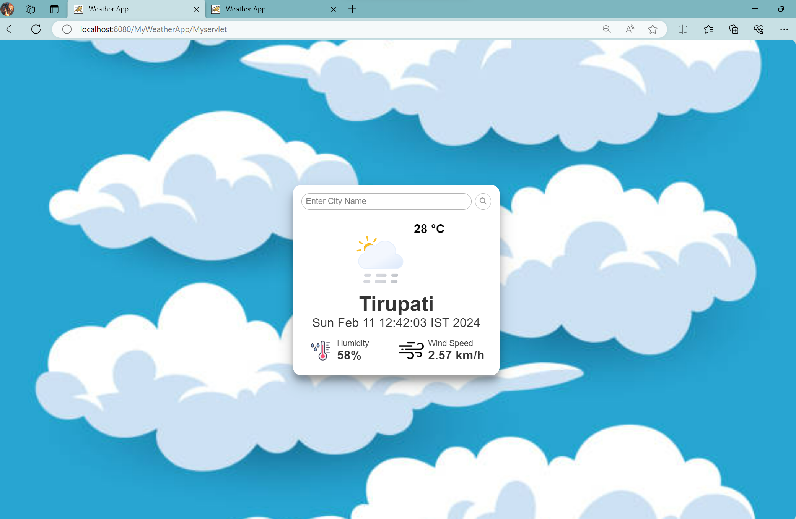

Slide 21
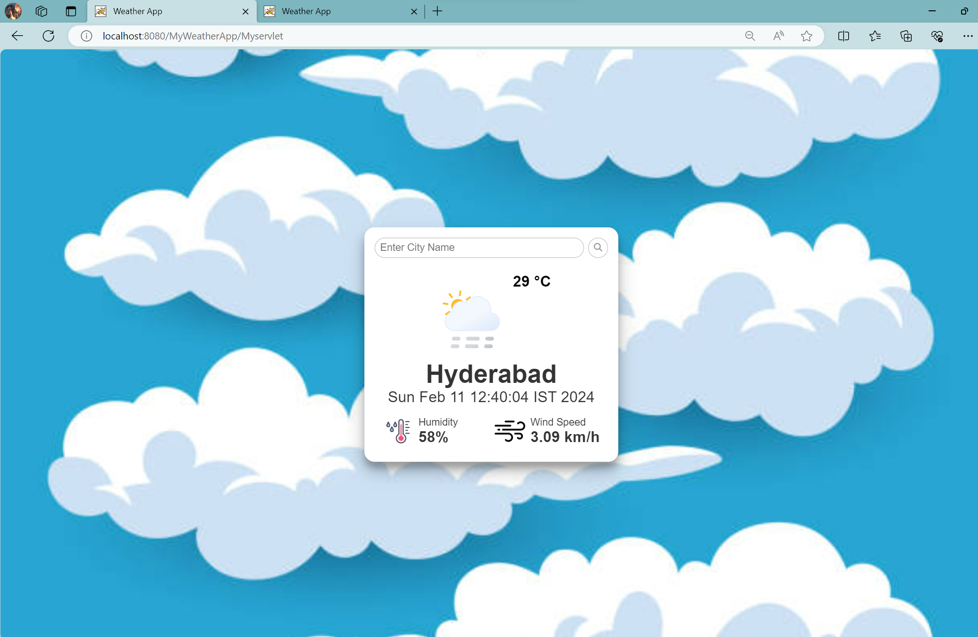

Slide 22
GITHUB LINK
https://github.com/dinesh-1511/WeatherMasterApp
VIDEO LINK
https://drive.google.com/file/d/1aYnd_-ab9tiGV5AGLrHEY5BVjNLWRl6k/view?usp=sharing

Slide 23
Thank you!
Notes:
thank you very much for joining this PPT, keep learning.
23

